Slide 1
Giant Eagle
Curbside Express Customer Retention
CMU Student Lab
Final Presentation
December 6, 2019

Slide 2
Agenda
Problem Statement
Approach
Results
Business Value
Q&A

Slide 3
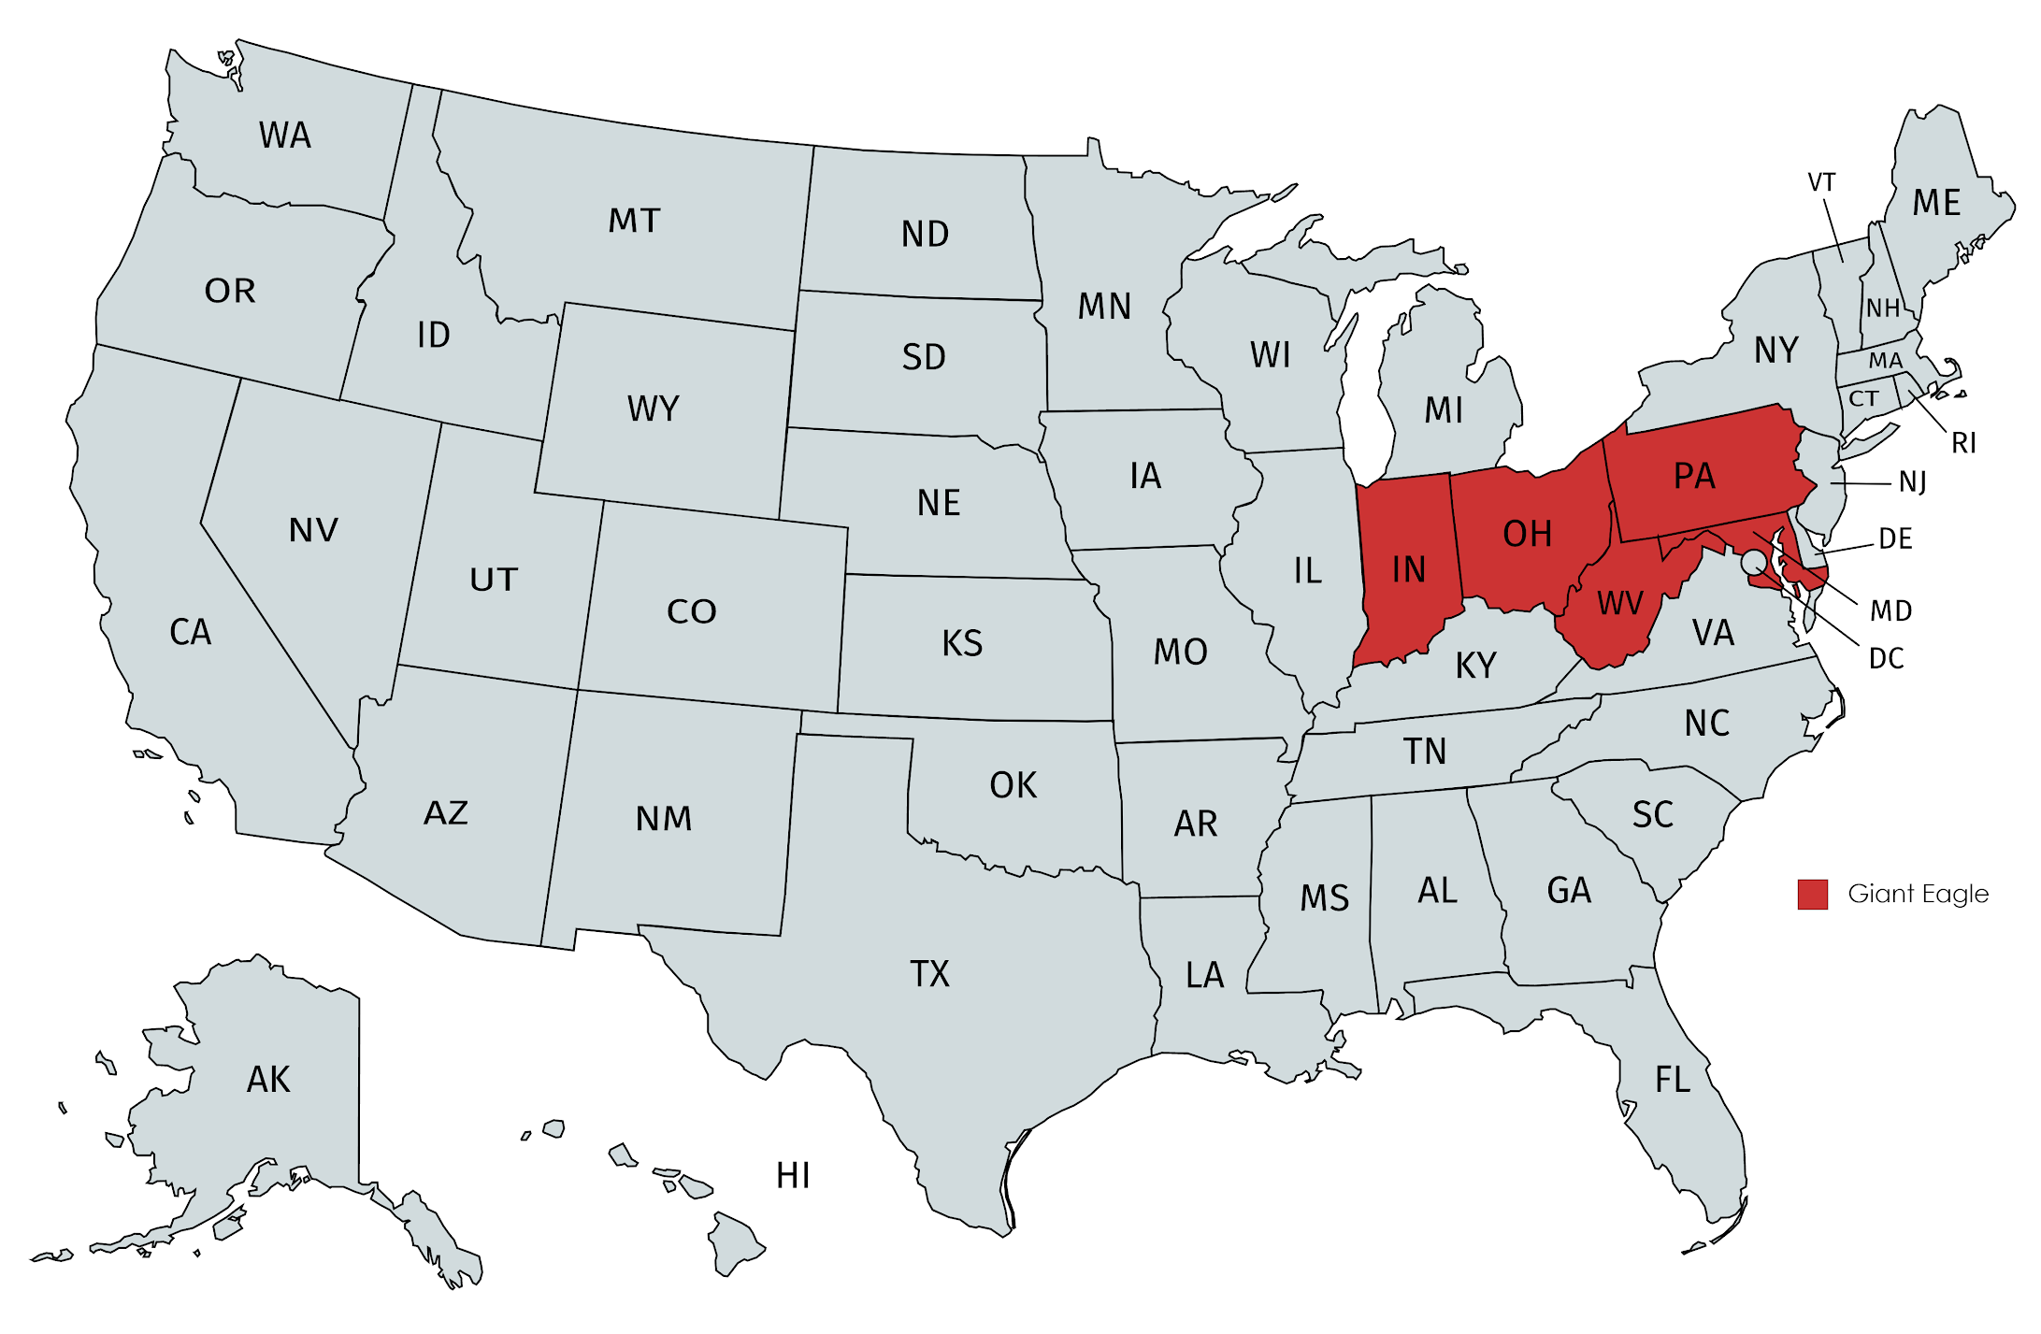



Giant Eagle: Company Background
Geographical Presence
Giant Eagle Brands
Notes:
Founded in 1918
32nd largest privately held corporation
216 stores of Giant Eagle & Market District combined

Slide 4




Giant Eagle: What sets them apart?
Loyalty Program
Online Offerings
Notes:
Advantage Card: Largest % of customers who use their loyalty program
Curbside Express: Launched in ____, available in ____ cities, used by 3% customers

Slide 5
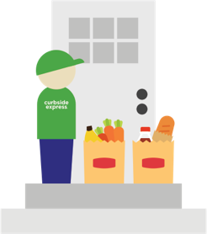
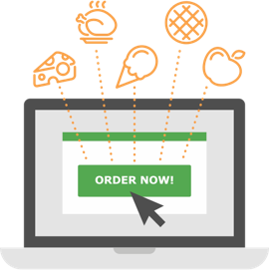


Curbside Express
Home Delivery
Customers Order Online
Staff Shops
Store Pick-up

Slide 6

Problem Statement
Situation:
The Curbside sales have become stagnant over the past two years and Giant Eagle is looking for avenues to increase Curbside engagement of customers.

Slide 7
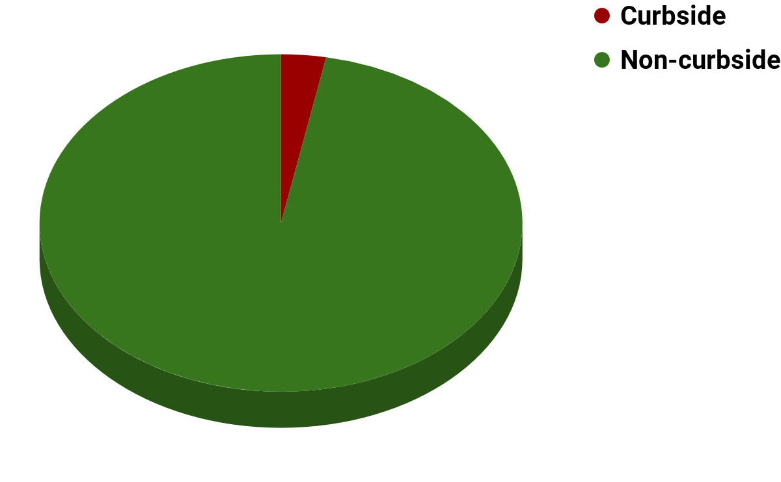
Problem Statement
Revenue
Revenue = Avg. Spend x No. of customers
Increase the Avg. Spend
Increase the No. of Customers
< 5%
Notes:
Will current in-store customers shift to curbside?
Is there variation in the buying behaviors of the curbside customers?

Slide 8
Our Approach
A
Are some customers more likely to shop on Curbside?
B
How do we target them?
Model customers’ likelihood to shop on Curbside
Identify customer segments to create customized marketing campaigns

Slide 9
A
Are some customers more likely to shop on Curbside?
B
How do we target them?
Approach
High
Chances of shopping on Curbside
Low

Slide 10
A
Are some customers more likely to shop on Curbside?
B
How do we target them?
Approach
High
Chances of shopping on Curbside
Low
Low
Predicted Curbside Spend ($)
High

Slide 11
A
Are some customers more likely to shop on Curbside?
B
How do we target them?
Approach
High
High chances of buying
+
High spend
Chances of shopping on Curbside
Low
Low
Predicted Curbside Spend ($)
High

Slide 12
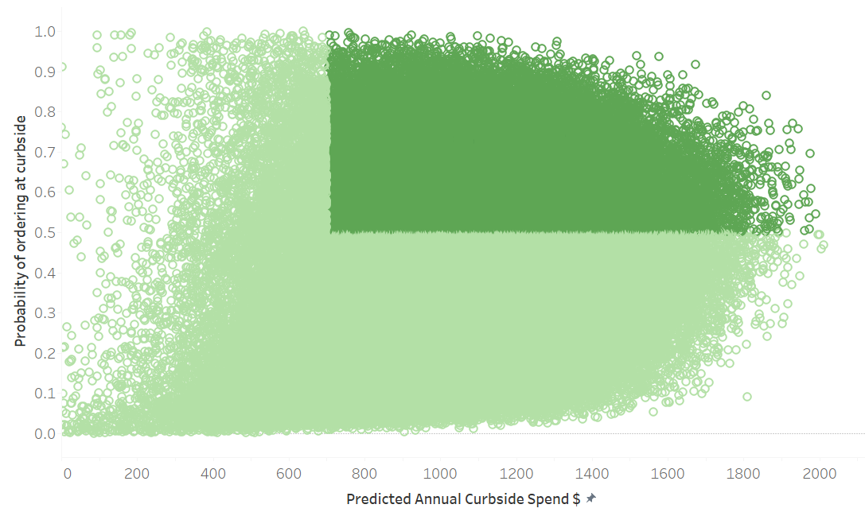
A
Are some customers more likely to shop on Curbside?
B
How do we target them?
Results
23%
customers
High
50% ↓
Chances of shopping on Curbside
← $700
Low
Low
Predicted Curbside Spend ($)
High

Slide 13

A
Are some customers more likely to shop on Curbside?
B
How do we target them?
Business Value
Focused Targeting Increase marketing to these 23% lucrative customers
Optimized Marketing Spend Reallocate funds or re-design marketing campaigns for non-lucrative customers
ROI

Slide 14
A
Are some customers more likely to shop on Curbside?
B
How do we target them?
Approach
Iterate
1. Define Segmentation Objective
Find attributes that make Curbside customers stick and not stick
2. Data Preparation
Decide on segmentation variables
3. Model Creation
Perform K-means clustering analysis
4. Segment Profiling
Infer which attitudes and attributes differentiate clusters

Slide 15




A
Are some customers more likely to shop on Curbside?
B
How do we target them?
Curbside Customer Segments
 | Meat Lovers | New Workforce | New Families | Health Conscious
% of market | 27% | 40% | 3% | 30%
Avg. Spend | $774 | $1,080 | $1,179 | $830
Characteristic | Prefer meal solutions | Prefer packaged foods | Kids | Smaller households
Notes:
Health Conscious: Prefer fresh produce

Slide 16

A
Are some customers more likely to shop on Curbside?
B
How do we target them?
Business Value
Improved Customer Experience Customized advertising campaigns that speak to specific segments
Improved Customer Loyalty Word of mouth publicity and trust from current Curbside customers
Customer Satisfaction

Slide 17
Wrap-up
A
Are some customers more likely to shop on Curbside?
B
How do we target them?
Identify prospects to target
Create customized marketing campaigns for segments
Improve Marketing ROI
Improve Customer Satisfaction

Slide 18


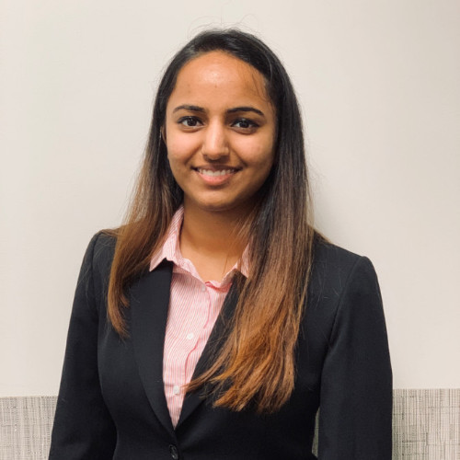
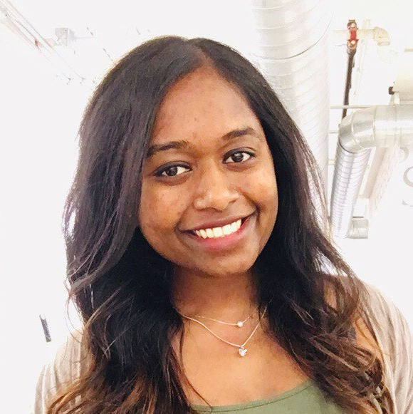
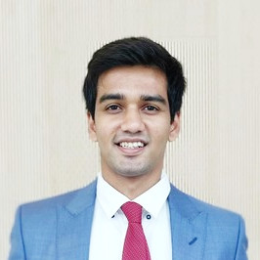


CMU Student Team
Aditi Mahajan
Tepper’20
Ankush Batra
Tepper’20
Arushi Vyas
Heinz’19
Yamuna Bhaskar
Heinz’19
Team Coordinator
Darshit Doshi
Heinz’19
Dhara Shah
Heinz’19
Kartik Joshi
Tepper’20

Slide 19



Advisory Team
Marcel Krutil
A.T. Kearney
Coach
Prof. Sunder Kekre
Tepper School
Faculty Advisor
Prof. T.K. Lim
Heinz College
Faculty Advisor

Slide 20
Giant Eagle Team
John Coleman Sr. CRM Analyst
Justin Weinstein Manager, Enterprise Personalization & Experience
Sid Luthra Senior Director, Innovation & Business Development
William Lewis Director, Analytics and Business Insights

Slide 21
Q&A

Slide 22
Appendix

Slide 23
A
Are some customers more likely to shop on Curbside?
B
How do we target them?
Important Factors
Independent Variables | Coefficient Value
Promotional Sensitivity | -356
No. adult 18 to 34 years | -272
No. adult 65 plus years | -92
No. children 11 to 17 years | -25
No. children up to 5 years | -16
No. adult 35 to 64 years | -11
Age | -2
Non-curbside Transactions | -1
Independent Variables | Coefficient Value
Vehicle Owned | 116
Income Bucket | 110
Household Size | 88
No. children 6 to 10 years | 16
Education | 12

Slide 24
A
Are some customers more likely to shop on Curbside?
B
How do we target them?
Curbside Customer Behavior Issue Tree
Household Buying Behavior
Household Demographics
Store Demographics
Purchase frequency
Avg. order amount
Product mix
Curbside fee
Pick-up vs Delivery
Promotional sensitivity
Value Score
Income
Age
# of adults
# of children
Occupation
Education
Competition
Proximity
Store type (size)
Available departments
Note: Features ranked in order of perceived priority.

